Slide 1
Facebook profiles profiling
By
Pankaj Kohli
INSAID

Slide 2
Agenda
Dataset Overview
Data Quality Review
Custom Columns
Exploratory Data Analysis:
Age
Gender
Age and Gender

Slide 3
Dataset Overview
User Id
Gender
Likes
Friends
Age
Friends initiated
Likes Received
Each data row identified by “userid” identifier
Primary data (Independent variables):
“Gender”: Qualitative Nominal (Categorical)
“Age”: Quantitative Discrete (Numerical)
Transactional data (Dependent variables):
Friendships initiated and friend count
Likes and Likes received (web/mobile)

Slide 4
Data Quality Review
Age:
Mean: 37
Max:113
Overall clean data
DOB and age match. Overall good data
Some Gender has missing values
Replace Null values as “trans”
Some rows have blank tenure:
Drop rows

Slide 5
Custom Columns
Date of Birth:
Raw data available as Day, month and year
Create column for any date wise analysis
Age Group:
Values : 0-10, 10-20,20-20….. 110-1120
Identified by upper limit of range.

Slide 6
Exploratory Data Analysis

Slide 7
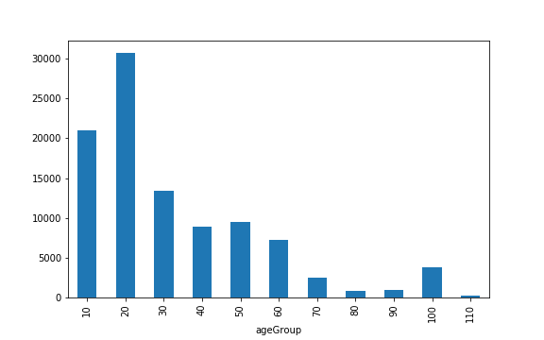
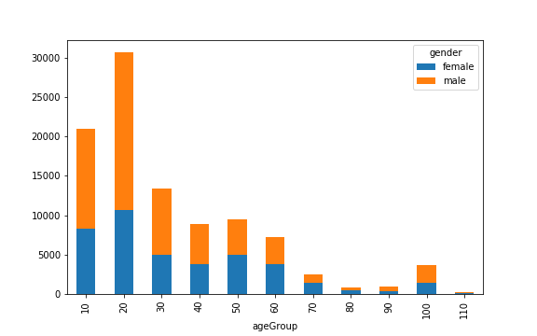
Demography
Age wise
Age-gender wise

Slide 8
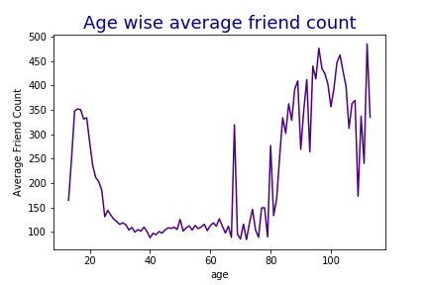
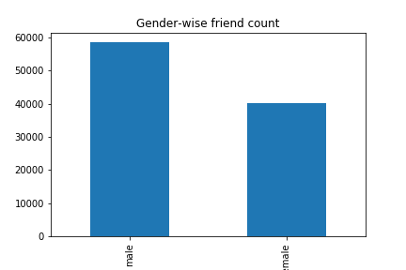
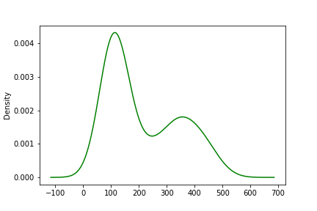
Friend Counts
Gender wise
Age wise

Slide 9
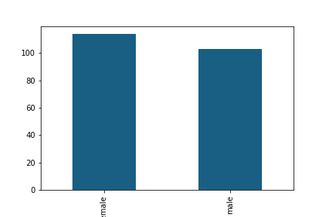
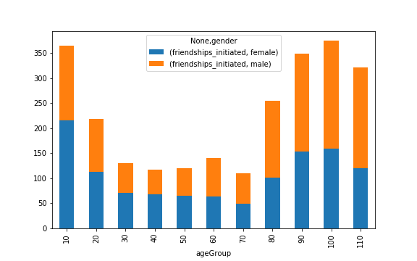
Friendships Initiated
Gender wise
Age group-Gender wise

Slide 10
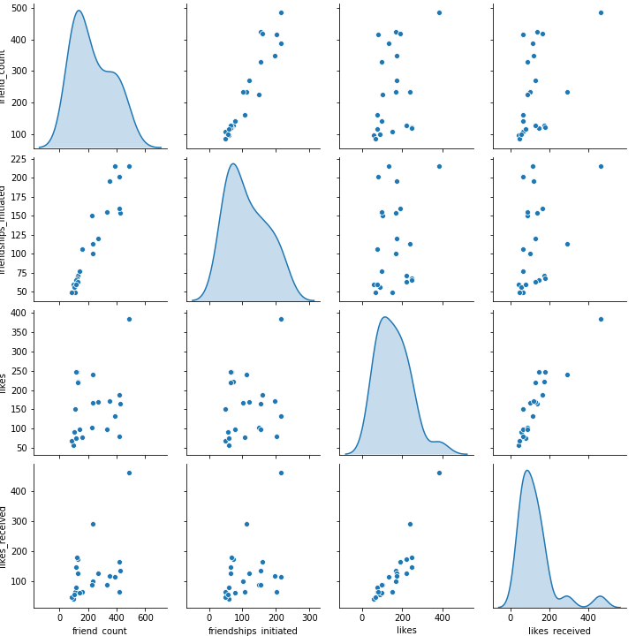
Pair plot – Age group, gender wise

Slide 11
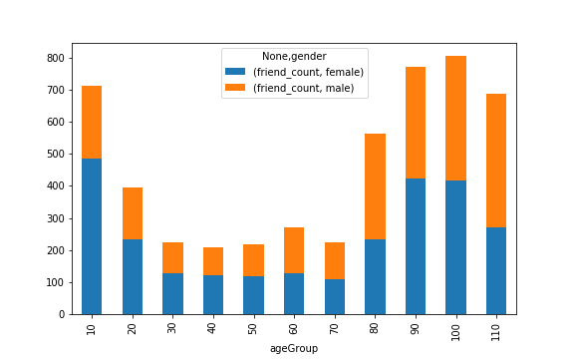
Social behavior - Friendship
Friends
Friends Initiated

Slide 12
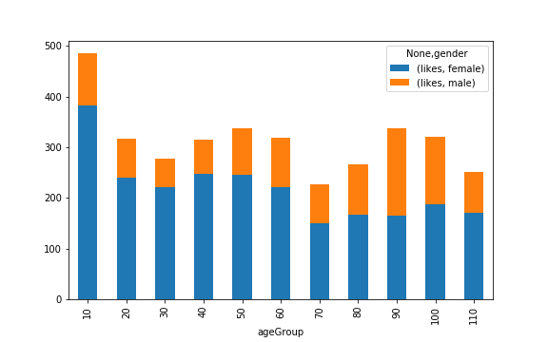
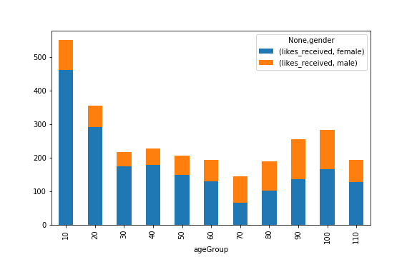
Social Behavior - Expression
Likes
Likes Received

Slide 13
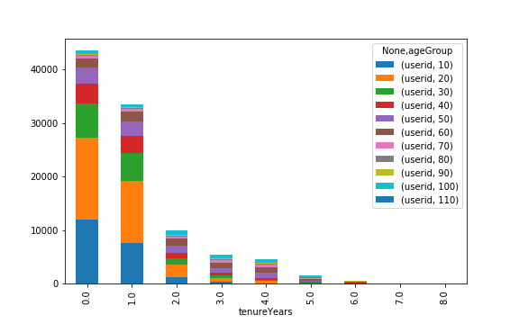
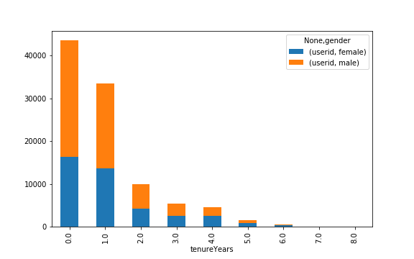
Tenure Analysis
Gender-wise tenure
Age group- gender wise

